Slide 1
Improving Traffic Flow Predictions with SGCN-LSTM: A Hybrid Model for Spatial and Temporal Dependencies -A Hybrid Approach to Smart Mobility
Roshini Joga
018221736

Slide 2
PROBLEM STATEMENT:
Traffic congestion causes delays, accidents, and environmental costs. SGCN-LSTM offers a hybrid model combining GCNs and LSTMs for accurate, efficient traffic predictions.
Large amounts of traffic can lead to negative effects such as increased car accidents, air pollution, and significant time wasted. Understanding traffic speeds on any given road segment can be highly beneficial for traffic management strategists seeking to reduce congestion.

Slide 3
Existing Solutions and Limitations:
Traditional methods fail to capture complex spatial-temporal dependencies.
STGCN: Accurate but computationally expensive.
A3T-GCN: Attention mechanism balances features but struggles with scalability.

Slide 4
PROPOSED SOLUTION:
The proposed SGCN-LSTM model addresses limitations in previous traffic prediction models by efficiently integrating spatial and temporal dependencies while reducing computational demands. It enhances performance through Signal-Enhanced Graph Convolutional Networks (SGCN) and Long Short-Term Memory (LSTM) networks, dynamically establishing node-level correlations using graph adjacency learning and attention mechanisms. Unlike static adjacency matrices, the model updates node correlations adaptively, improving accuracy and scalability.
By combining the spatial handling of GCNs and the temporal dynamics of LSTMs, the model delivers reliable predictions with reduced error. This hybrid approach is optimized for practical deployment, especially in large-scale metropolitan traffic systems.

Slide 5
METHODOLOGY:
2.1 Dataset PEMS-BAY is a widely recognized public traffic dataset containing temporal traffic data for road segments in the Bay Area
2.2 Graph Preprocessing and Feature Embedding
2.3 Graph to Signal Conversion
2.4 The SGCN-LSTM Model Architecture
2.5 Training and Validation

Slide 6
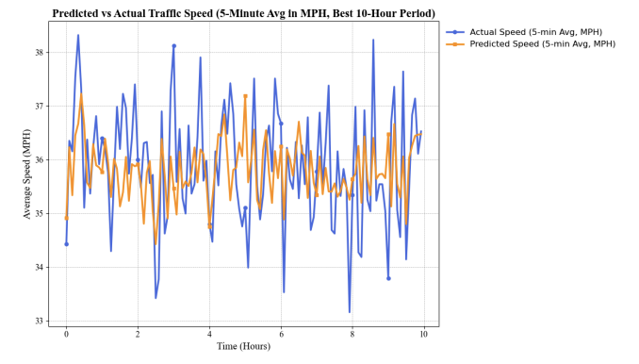
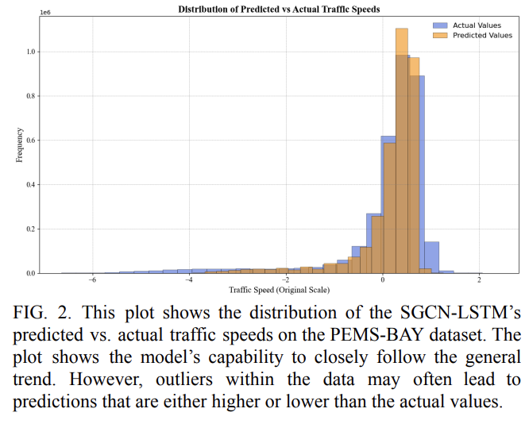
This figure shows the average traffic speed (in MPH) over 5-minute intervals for a 10-hour period, comparing the actual recorded speeds (in blue) against the model's predicted speeds (in orange).

Slide 7
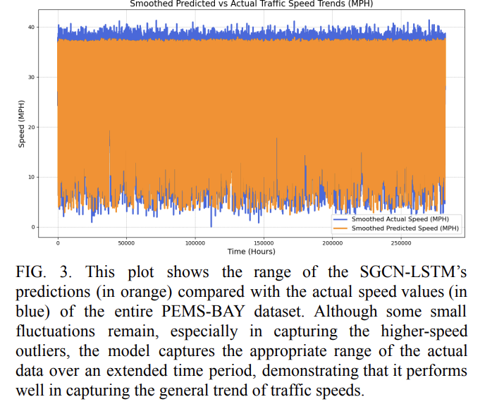
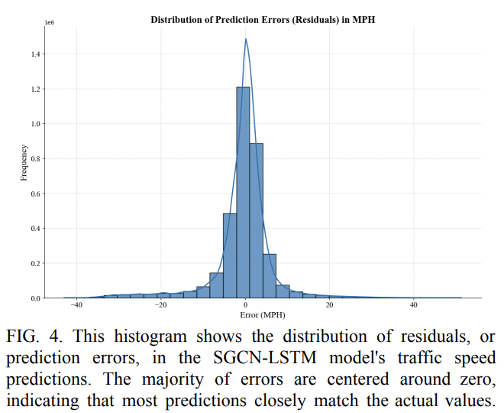
RESULTS:

Slide 8
PERFORMANCE ANALYSIS:
PEMS-BAY Dataset:
- MAE: 0.4347
- RMSE: 0.7946
Outperforms baselines (STGCN, A3T-GCN) in all metrics.

Slide 9
Challenges and Future Directions
Data quality: Missing/noisy data impacts accuracy.
Scalability: Requires high-performance hardware for larger datasets.
Future work: Extend predictions to longer intervals; predict traffic volume/density.

Slide 10
Real-World Applications
Optimize traffic signals.
Provide real-time navigation updates.
Aid urban planning with data-driven insights.
Assist emergency services in avoiding congestion.

Slide 11
FUTURE WORK:
Aimed to further evaluate the SGCN-LSTM’s capabilities by testing its performance on a wider range of time intervals within the PEMS-BAY dataset, such as 15-minute, 30-minute, and 60-minute intervals.
Expand analysis to other traffic flow metrics, such as traffic volume, to assess the model’s generalization capabilities.

Slide 12
REFERENCES:
[1] A. A. Mohammed, K. Ambak, A. M. Mosa, and D. Syamsunur, “A Review of Traffic Accidents and Related Practices Worldwide,” The Open Transportation Journal, vol. 13, no. 1, 2019, Available: https://www.opentransportationjournal.com/VOLUME/ 13/PAGE/65/FULLTEXT/
[2] O. J. Adeyemi, A. A. Arif, and R. Paul, “Exploring the relationship of rush hour period and fatal and non-fatal crash injuries in the U.S.: A systematic review and meta-analysis,” Accident Analysis & Prevention, vol. 163, p. 106462, Dec. 2021, doi: https://doi.org/10.1016/j.aap.2021.106462.
[3] M. M. Hamed, H. R. Al-Masaeid, and Z. M. B. Said, “Short-Term Prediction of Traffic Volume in Urban Arterials,” Journal of Transportation Engineering, vol. 121, no. 3, pp. 249–254, May 1995, doi: https://doi.org/10.1061/(asce)0733-947x(1995)121:3(2 49).
[4] W. Jiang and L. Zhang, "Geospatial data to images: A deep-learning framework for traffic forecasting," in Tsinghua Science and Technology, vol. 24, no. 1, pp. 52-64, Feb. 2019, doi: 10.26599/TST.2018.9010033.

